Slide 1
The Blue Chip
(FIN 627-A)

Slide 2
Introduction to the Fund
The Blue Chip Fund was established on 20th October, 2022
The Blue Chip Fund is a hedge fund which has minimum initial investment requirement of $100,000 and a lock-up period of 2 years
We are currently invested in the stocks comprising the Goldman Sach’s Capex and R&D basket
The investable universe for The Blue Chip Fund is the stocks traded on the U.S. stock markets comprising NYSE and NASDAQ
Redemption period is 3 months for the fund, which means that the investors need to apply for the redemption 3 months in advance

Slide 3
Investment Process
Investment Mandate and Philosophy
Mandate: The Blue Chip Fund is an actively managed fund which invests in companies that are actively spending on Capital expenditures and R&D
Benchmark: We consider S&P 500 as the benchmark to measure and compare our fund’s performance
Fund AUM: Assets under management for The Blue Chip Fund are approximately $1.1 Million +
Philosophy: We believe that companies which are actively spending on R&D and other capital expenditures would have a higher growth rate in future over the longer term

Slide 4
Investment Process
Investment Term and changes in holdings
Investment Horizon
Since we invest in stocks that are focused on R&D and Capex, we hold our stocks for a long term to gain the benefits of capex and R&D expenditure in the form higher growth in the future
The average investment period for each stock is around between 3 to 4 years
Portfolio Rebalancing
We rebalance our portfolio on a quarterly basis according to the trends and developments in the markets as per the Head of Research and CRO’s advice
Although we take the market trends into account, but we give a higher weightage and priority to solver recommendation

Slide 5
Investment Process
Portfolio – List of Stocks

Slide 6
Investment Process
Allocation through Variance Covariance Matrix

Slide 7
Investment Process
Allocation through Variance Covariance Matrix

Slide 8
Investment Process
Setting up the Solver
Criteria and conditions used in the solver:
Main aim is to minimize portfolio standard deviation
Annualized portfolio return of more than or equal to 20%
Minimum weightage of 1% for each stock in the portfolio
There cannot be negative weights in any stock
Planned updates in calculations which are in the pipeline:
We are trying to obtain the forecasts from different financial institutions for each stock
We shall then include these forecasts to obtain their expected returns and use them in the average returns
We are also trying to include Value at Risk as a measure of risk instead of standard deviation
Inputs for estimating returns (CAPM)
Risk-free rate is assumed to be 3.80% which was the 10-year US Treasury yield on 14th November
Market returns are assumed to be 11.73% which is the average annualized return of S&P 500 over the past 4 years

Slide 9
Risk Management
Risk hedging measures for The Blue Chip Fund
Active Risk Monitoring
We actively monitor the Value at Risk for the portfolio and try to keep it under a predetermined level
Diversification
Timely rebalancing of portfolio
We use solver for finding the optimal weights of the stocks and rebalance the portfolio on a quarterly basis
Diversification is the top source of risk mitigation that our fund uses
Our portfolio consists of 50 stocks which helps us reduce the unsystematic risk
Liquidity and Redemption Risk
We plan to keep a minimum 2% of the portfolio value as cash balance to mitigate the liquidity risk

Slide 10
Economic Outlook
Interest Rates
Coronavirus Pandemic
Russia Ukraine War
40-year high CPI Index
Fed Interest Rate Hikes
Increased Borrowing Cost
Reduced Demand
Fair Levels of Inflation
The main question is WHETHER FED CAN BRING DOWN INFLATION WITHOUT CAUSING RECESSION

Slide 11
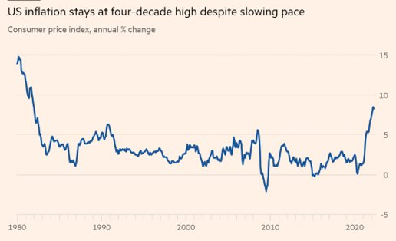
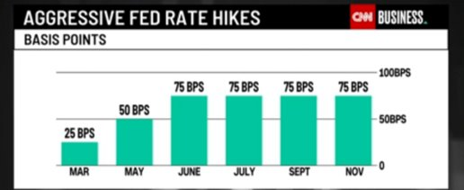
Economic Outlook
Fed Rates and Inflation
Source: Refinitiv
Source: CNN Business

Slide 12
Economic Outlook
Effect of Fed Interest Rate Hike in 2023
Individuals
Credit Card Interest
Mortgages
Global Economy
Mild recession in 2023
CPI to fall to 3.20% YoY by Q4 2023
Layoffs
Increased rate by 5.00%-5.25% by March 2023
Solution for Individuals and Investors
Start paying your high-interest debt as there is a high possibility that the interest rates will keep rising in 2023.​
Diversify your portfolio and focus on long-term returns. ​
(Bank of America Report- US Economic Viewpoint 2023 US outlook: A policy-driven downturn)

Slide 13
Performance Report
Best and Worst performers
Total unrealized profit of The Blue Chip Fund is $10,700
While rebalancing our portfolio after incorporating the CAPM returns on 25th November, 2022 we realized a profit of ~$98,000
Top 3 Performing Stocks
Worst 3 Performing Stocks
Stock | Capital Gains
Guild Holdings Co. (GILD) | 32.65%
Universal Health Services (UHS) | 32.15%
Pfizer Inc. (PFE) | 23.11%
Stock | Capital Losses
Lumen Technologies Inc. (LUMN) | -21.43%
Devon Energy Corp (DVN) | -13.95%
Diamondback Energy Inc. (FANG) | -12.62%
Total Returns
Returns Summary | Value
Initial Portfolio Value | $1,000,000
Portfolio Value as on 12/11/2022 | $1,108,731
Total Rate of Return | 10.87%

